Slide 1
Properties of expectation, variance and conditional probabilities
From: An Introduction to DATA ANALYSIS and UNCERTAINTY QUANTIFICATION for INVERSE PROBLEMS by Luis Tenorio

Slide 2
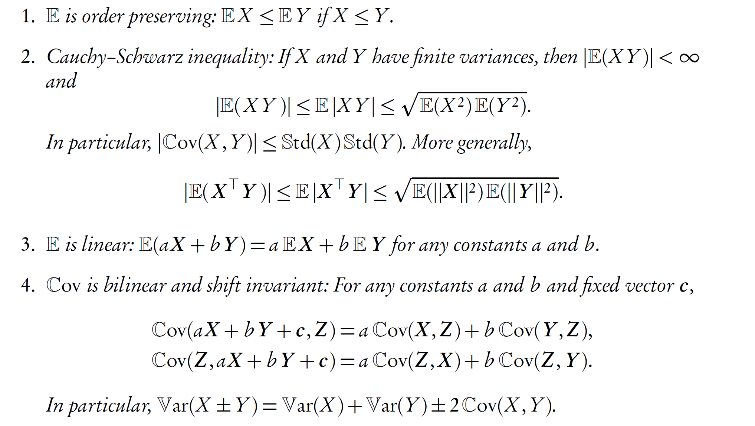
Properties of expectation and variance

Slide 3
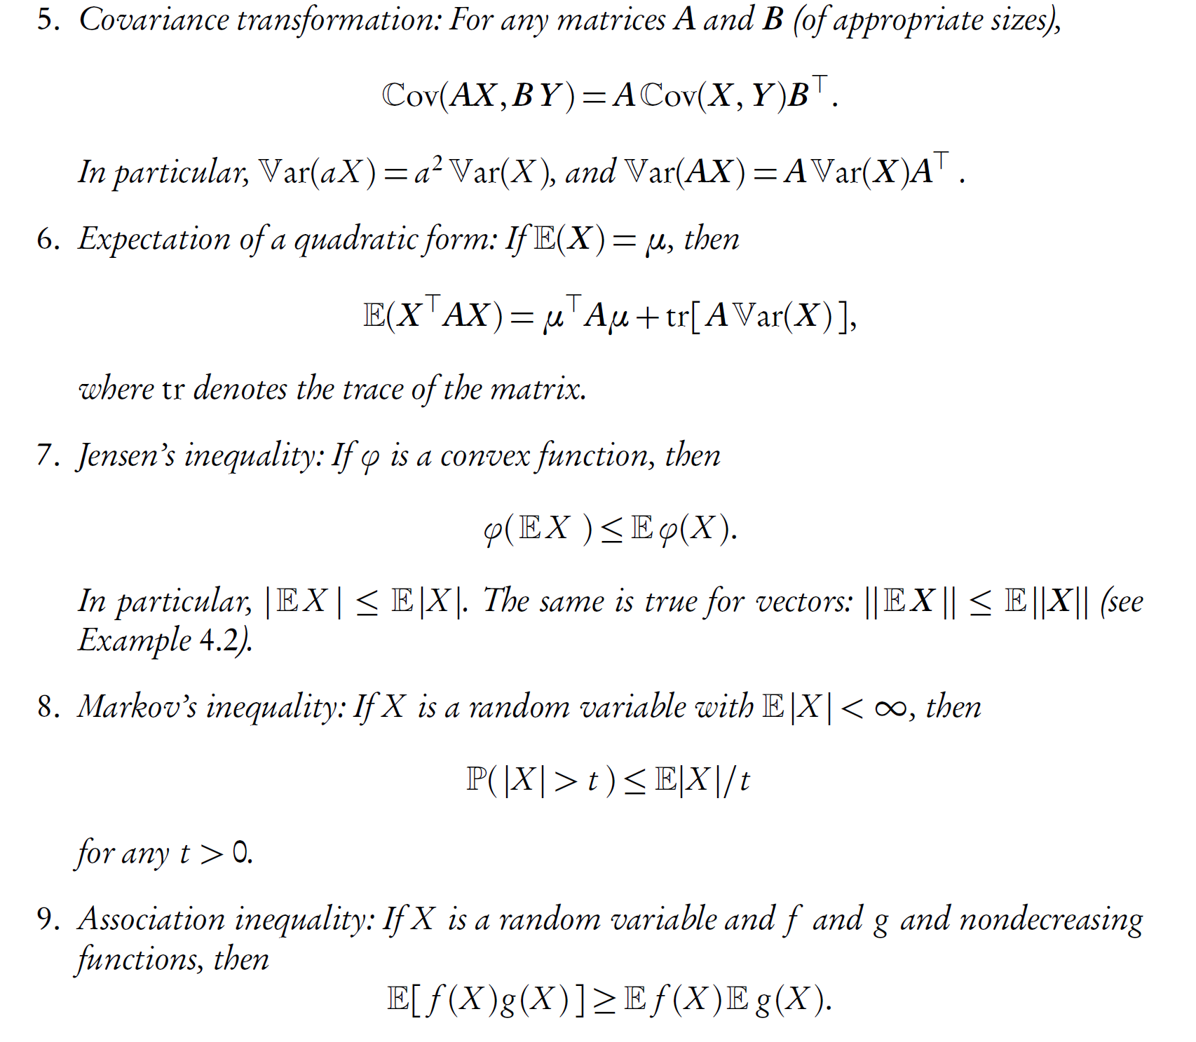

Slide 4
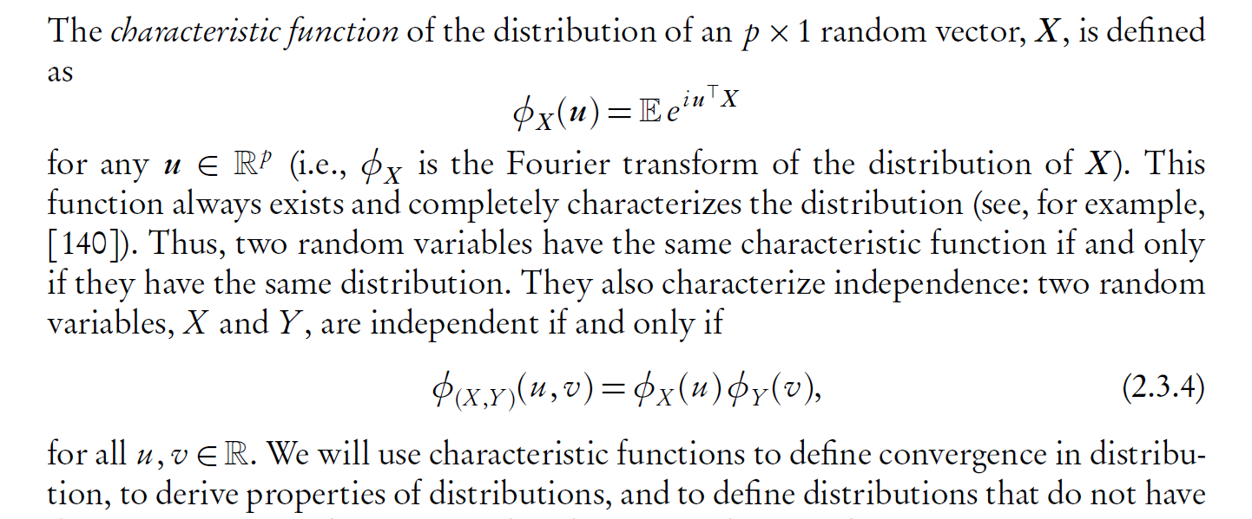
Characteristic function

Slide 5
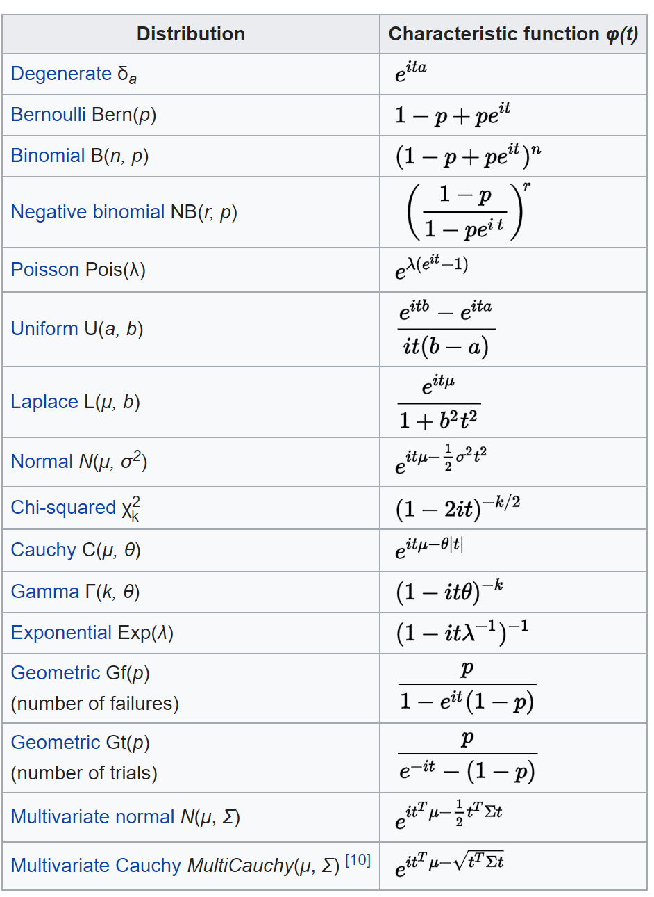
[from Wikipedia]

Slide 6
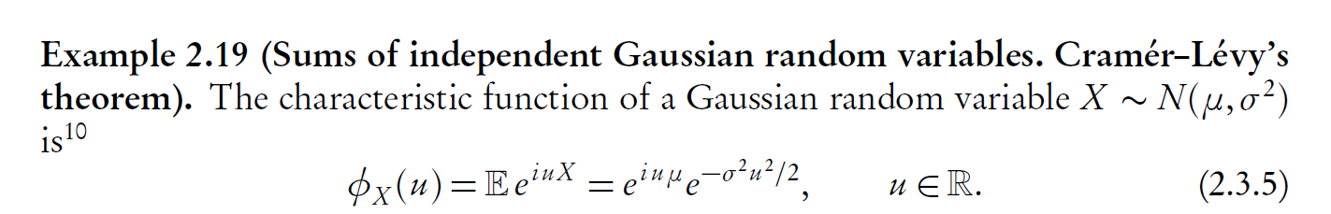

Slide 7
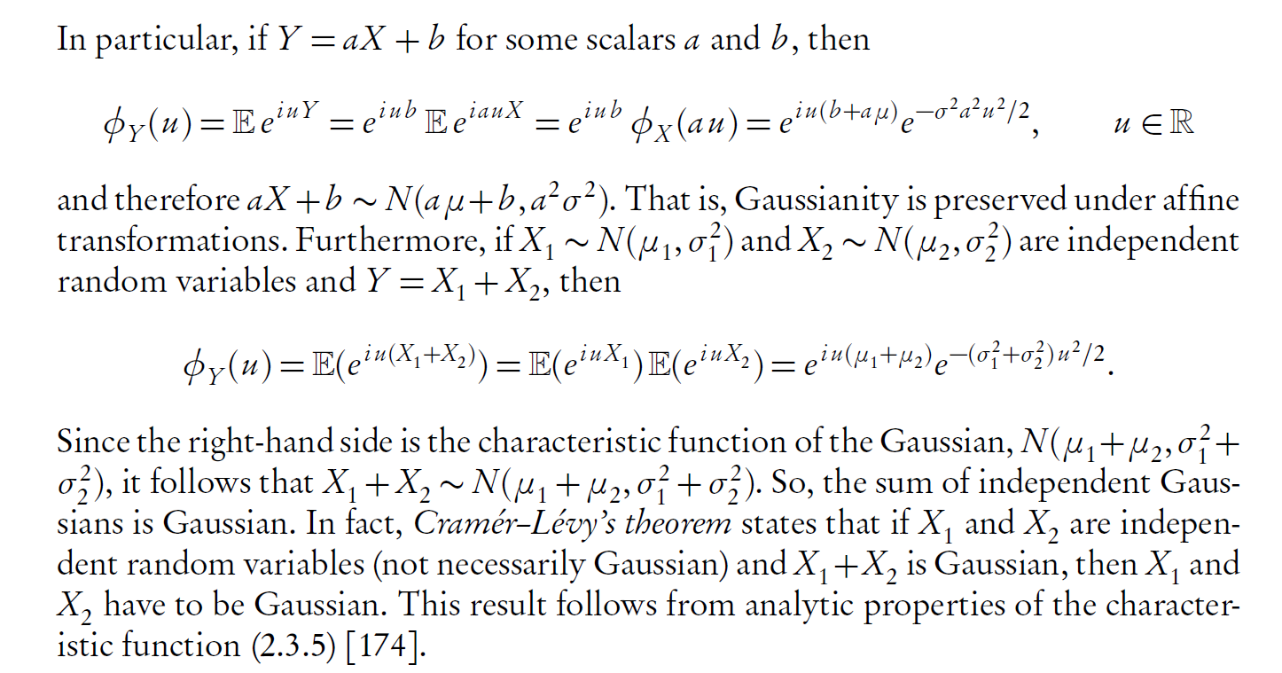

Slide 8
Using characteristic functions for data analysis
[from Wikipedia] Characteristic functions can be used as part of procedures for fitting probability distributions to samples of data. Cases where this provides a practicable option compared to other possibilities include fitting the stable distribution since closed form expressions for the density are not available which makes implementation of maximum likelihood estimation difficult. Estimation procedures are available which match the theoretical characteristic function to the empirical characteristic function, calculated from the data. Paulson et al. (1975) and Heathcote (1977) provide some theoretical background for such an estimation procedure. In addition, Yu (2004) describes applications of empirical characteristic functions to fit time series models where likelihood procedures are impractical.

Slide 9
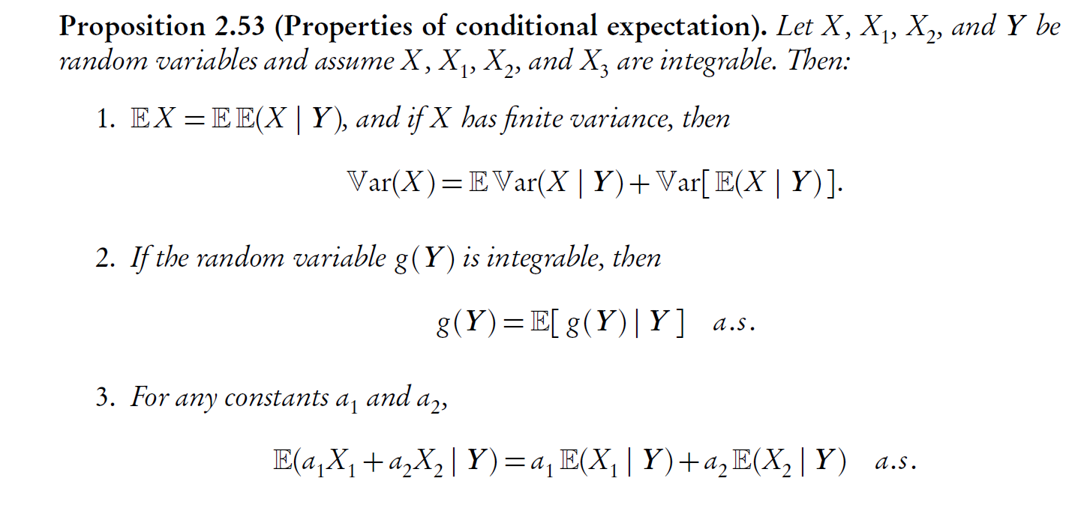
Properties of conditional expectation

Slide 10
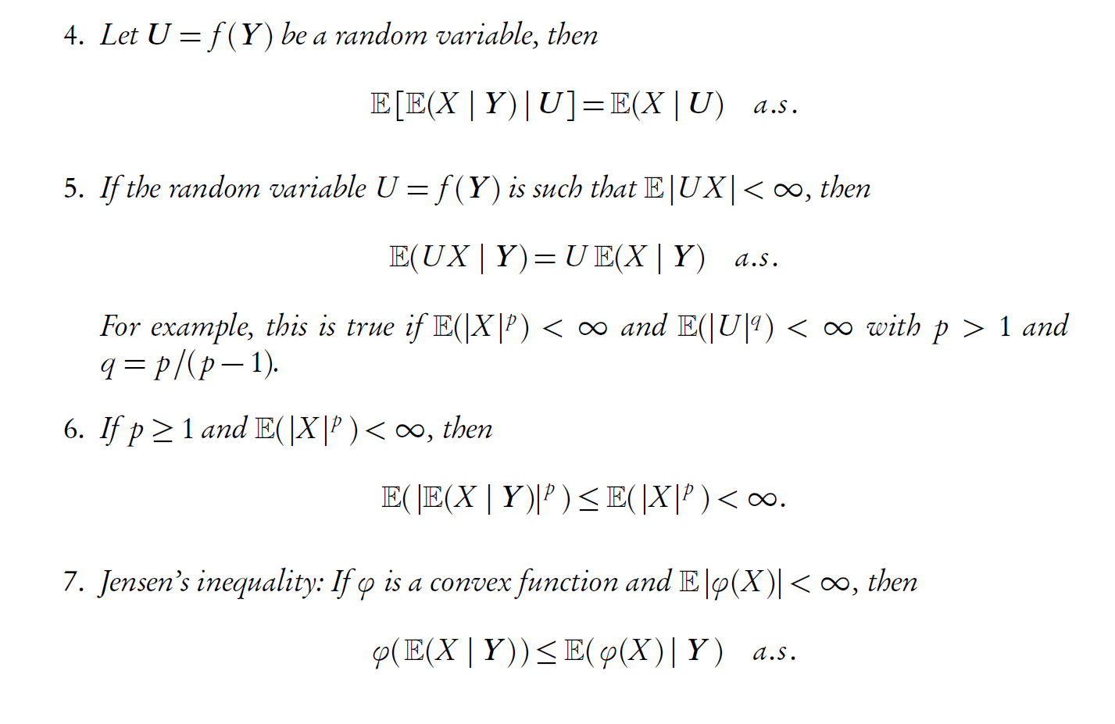

Slide 11
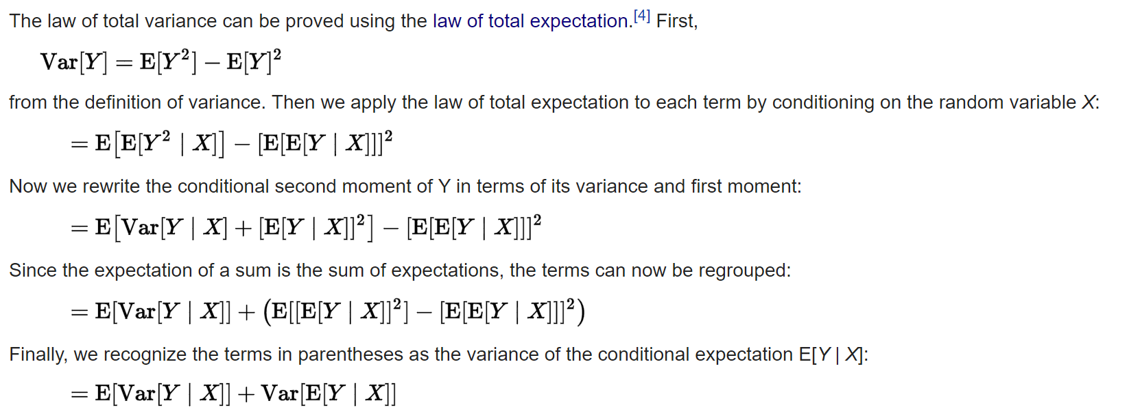
Proof of property 1

Slide 12
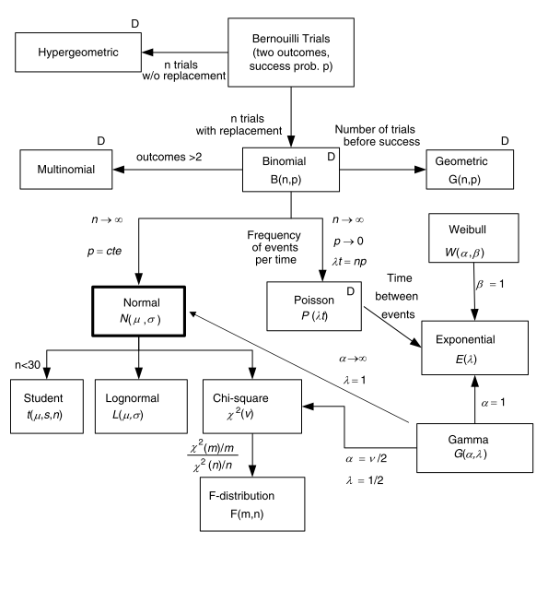
Distributions

Slide 13
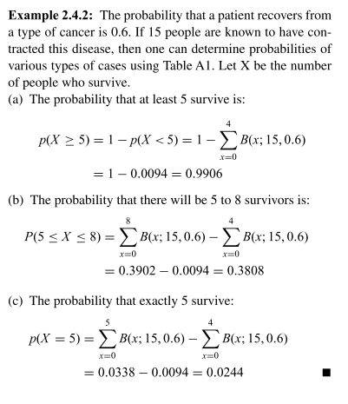
Binomial distribution

Slide 14
Poisson distribution
Poisson experiments are those that involve the number of outcomes of a random variable X which occur per unit time (or space).
A Poisson experiment is characterized by:
independent outcomes (also referred to as memoryless),
probability that a single outcome will occur during a very short time is proportional to the length of the time interval, and
probability that more than one outcome occurs during a very short time is negligible.
Applications
the number of faults in a length of cable
number of cars in a fixed length of roadway or number of cars passing a point in a fixed time interval (traffic flow),
counts of a-particles in radio-active decay,
number of arrivals in an interval of time (queuing theory)

Slide 15
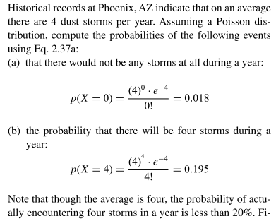
Poisson

Slide 16

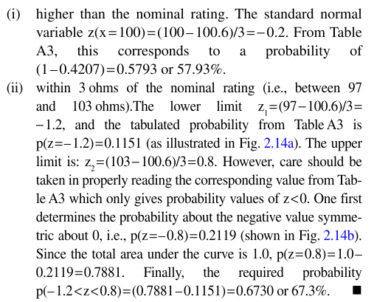
Normal distribution
It is used to model events which occur by chance such as variation of dimensions of mass-produced items during manufacturing, experimental errors, variability in measurable biological characteristics such as people’s height or weight,… Of great practical import is that normal distributions apply in situations where the random variable is the result of a sum of several other variable quantities acting independently on the system.

Slide 17
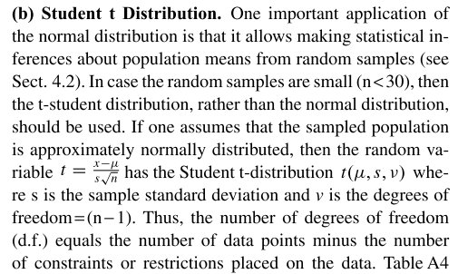
Student t distribution

Slide 18
Gamma
It is a good candidate for modeling random phenomena which can only be positive and are unimodal.

Slide 19
Exponential
It is the continuous distribution analogue to the geometric distribution which applied to the discrete case.
It is used to model the interval between two occurrences, e.g. the distance between consecutive faults in a cable, or the time between chance failures of a component (such as a fuse) or a system, or the time between consecutive emissions of α-particles, or the time between successive arrivals at a service facility.

Slide 20
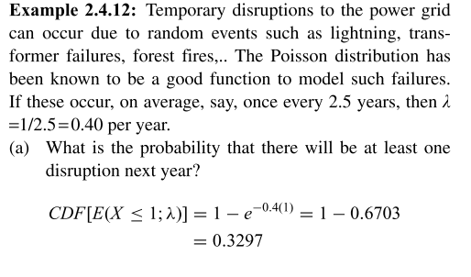
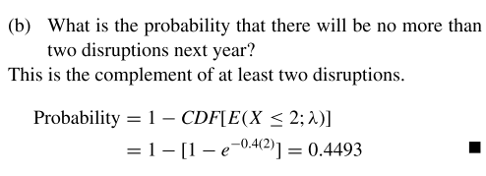
Exponential

Slide 21
Other distributions
Student-t: comparison between two sample means
Weibull: reliability and life testing; for example, to model the time of failure or life of a component
Chi-square Distribution: plays an important role in inferential statistics where it is used as a test of significance for hypothesis testing and analysis of variance type of problems.

Slide 22
Bayesian analysis

